Slide 1
Emotion Detection with CNNs
Yair Haendler
Michael Riedeman

Slide 2
Overview
Background
Problem Statement
Data Acquisition
Baseline
Preprocessing
Model Characteristics
Model Performance
Conclusions/Recommendations

Slide 3
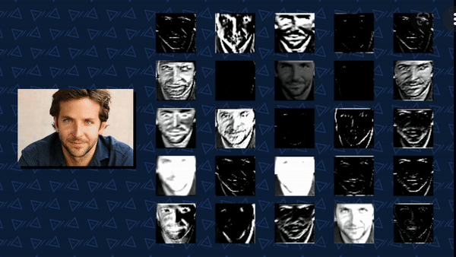
Background
Image Recognition
Detecting Facial Features
Convolutional Neural Networks

Slide 4
Problem Statement
Construct a model predicting human emotions by detecting facial expressions in images.
Binary Classification of “happy” and “neutral”
Emphasis on diversity

Slide 5
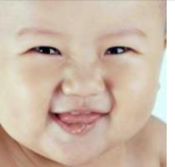



Data Acquisition
Image source
UTKFace online database of human faces
20,000 images of people aged 0 to 116
Labeled by us.

Slide 6
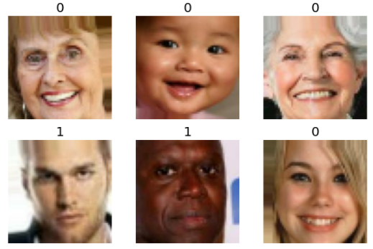
Baseline Model
Baseline - 50%
1000 happy faces
1000 neutral faces

Slide 7
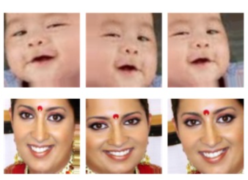
Preprocessing
Data Augmentation
Train-Validation Split
10,727 training set
1893 test set
Rescaling

Slide 8
Model Characteristics
Layer | Activation | Normalization | Regularization
Conv2D (2) | ReLU | Batch | L2
SeparableConv2D | ReLU | Batch | L2
MaxPooling2D | - | - | -
SeparableConv2D | ReLU | Batch | L2
GlobalAveragePooling | - | - | -
Dense Output | Sigmoid | - | -

Slide 9
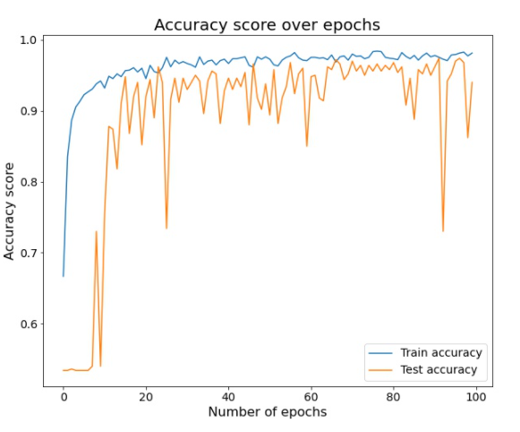
Model Performance
Adjustments
Learning Rate
Epochs
Layers

Slide 10
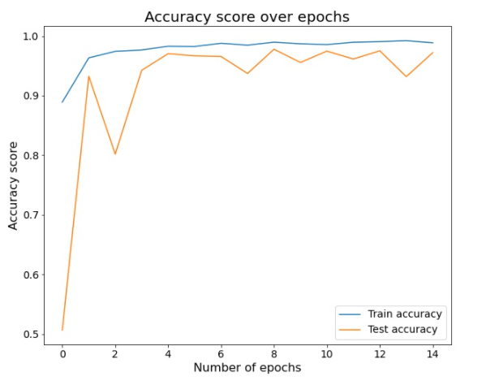
Model Performance
Baseline 50%
Training Data 98.8%
Validation Data 97.2%
Test Data 95.5%

Slide 11
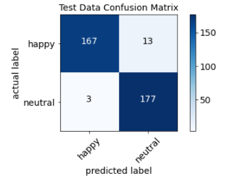
Model Performance
Race:
Asian - 95.0%
Dark Complexion- 90.0%
White – 96.6%
Age:
Elderly – 84.4%
Adults – 98.8%
Children – 96.7%
Babies – 95.5%

Slide 12
Conclusions/Recommendations
Slightly Overfit 98.8% train vs. 97.2% validation
Building block for further implementation
Pretrained model
Additional layers

